Slide 1
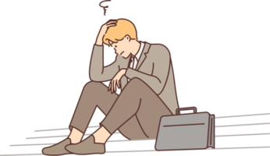
Unemployment

Slide 2
Meet our team
Muhammad Talha
FA23-BSE-000
Hamid Abdullah
FA23-BSE-042
Hashir jadoon
FA23-BSE-000
Habib shah
FA23-BSE-000

Slide 3

What is unemployment?
Unemployment is a condition where individuals capable of working are unable to find suitable employment opportunities.

Slide 4
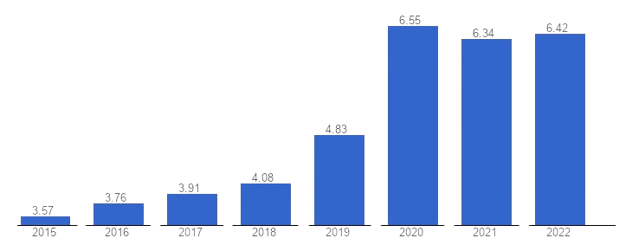
Ratio of Unemployment In Pakistan
Recent reports indicate that millions of individuals in the country are facing unemployment, making it a major economic and social challenges.
Graph shows a rapid increase in unemployment in Pakistan after 2029, possibly due to COVID-19.
Subsequent years indicate a consistently high unemployment ratio.

Slide 5
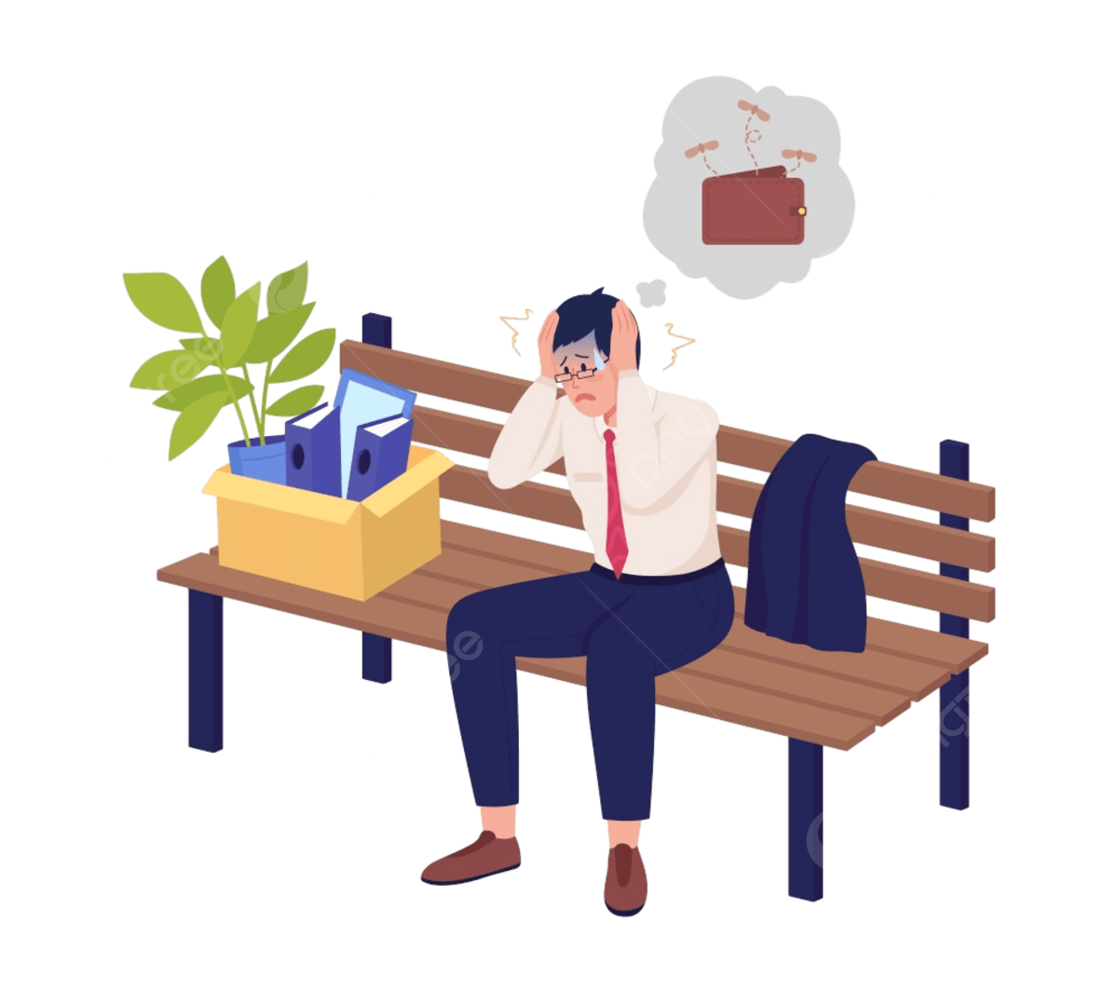
Effects of unemployment
Financial instability for individuals and families.
Rise in poverty and social issues such as crime.
Decreased consumer spending and weakened economic growth.
Increased demand on social services, straining public resources.

Slide 6


But what are the causes of unemployment ?

Slide 7
Causes of unemployment
Faulty education and​ lack of educational institutes
About 5.5 million children are out of schools
More then 70% industrial units have been closed due to energy Crises.
Child labor is also a common cause of unemployment
Rapid population growth is also among the causes of unemployment

Slide 8

Solutions of unemployment
Government initiatives: Employment programs, infrastructure projects.
Promoting small businesses and economic diversification .
Investing in education and skill development to match market needs.
Encouraging entrepreneurship and innovation.
International cooperation to create job opportunities.

Slide 9

Conclusion
Unemployment is a multifaceted challenge with profound effects on individuals, communities, and the economy.
We've explored the various causes, from population growth to technological changes.
Solutions lie in comprehensive strategies, including government initiatives, economic diversification, and investment in education.
As we conclude, let us recognize that overcoming unemployment is not just an economic imperative but a social responsibility, vital for the well-being and progress of our nation.

Slide 10

Any Questions?
Thank You

